Slide 1
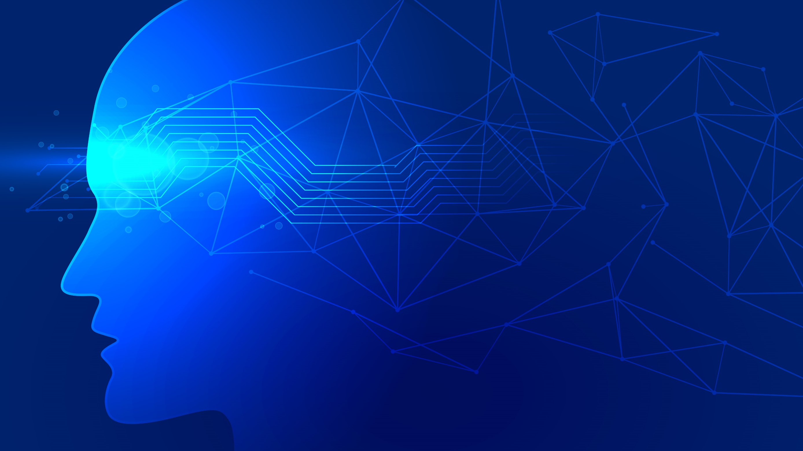

MULTIMODEL 3D BRAIN TUMOR
SEGMENTATION USING DEEP LEARNING
Research Base(AI)

Slide 2
Name Registration #
Wahab Ahmad L1F20BSCS0455
M.Ibtisam Ahmad L1F20BSCS0456
Talha Saeed L1F20BSCS0476

Slide 3

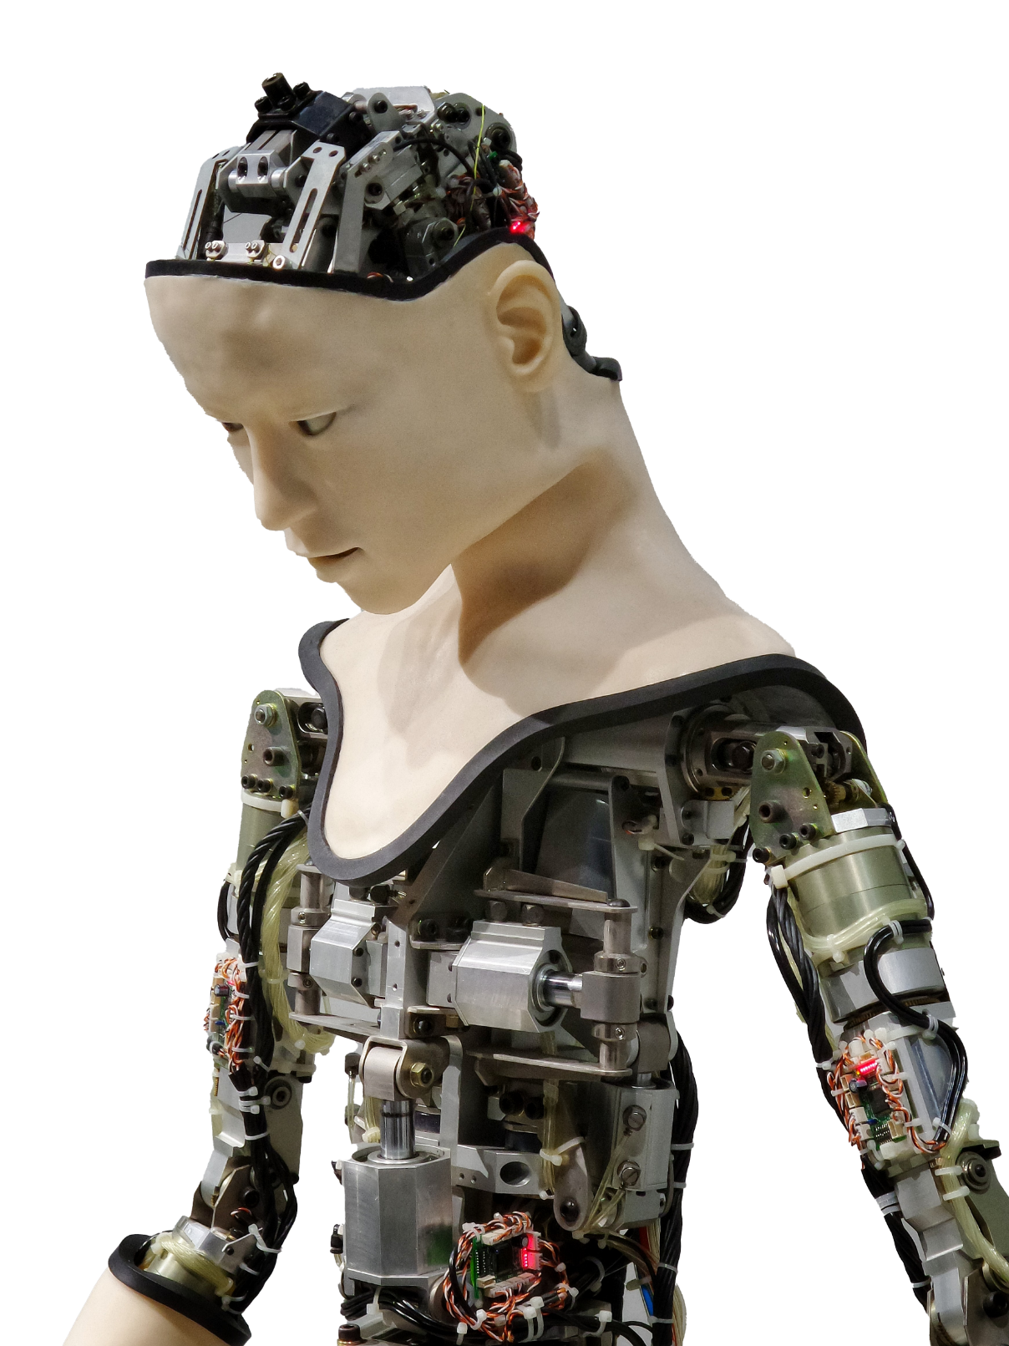

Introduction
Accurate and reliable brain tumor segmentation is essential for effective medical decision-making. Traditional single-modal segmentation methods often face challenges in distinguishing tumor regions from healthy brain tissue due to variations in tumor appearance and image noise. Multimodal imaging, which combines data from multiple MRI modalities, can provide complementary information and potentially improve segmentation accuracy.

Slide 4
Solution
The proposed solution revolves around the development and implementation of a multimodal 3D deep learning framework specifically tailored for brain tumor segmentation. This framework aims to capitalize on the integrating of multiple MRI modalities to overcome the limitations of single-modal segmentation methods.

Slide 5
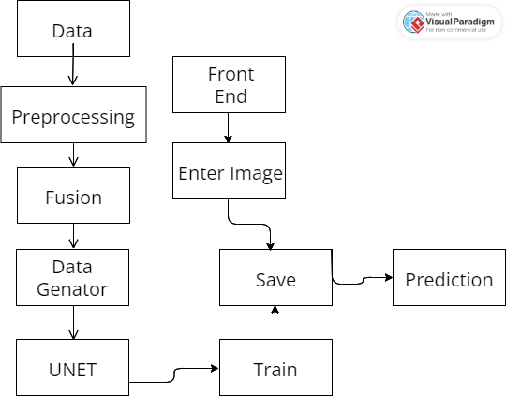
Architect

Slide 6

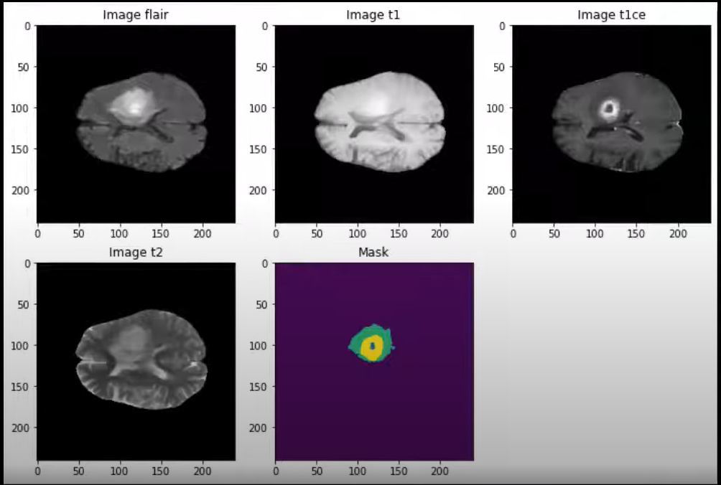
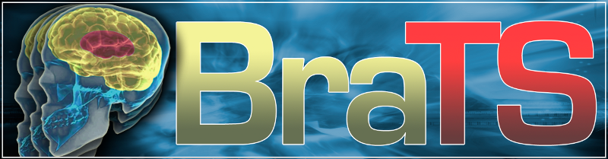
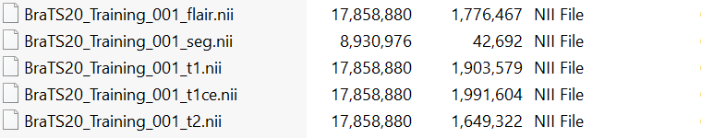
DataSet

Slide 7
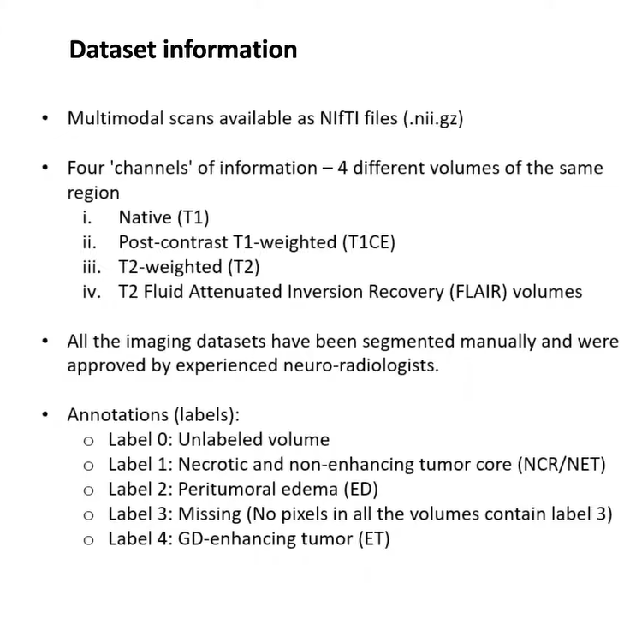

Slide 8
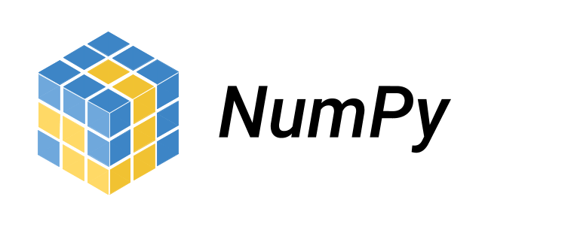
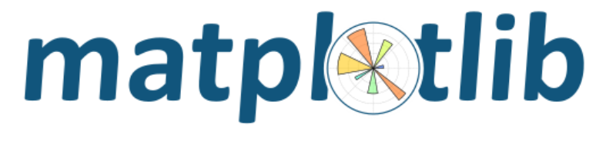
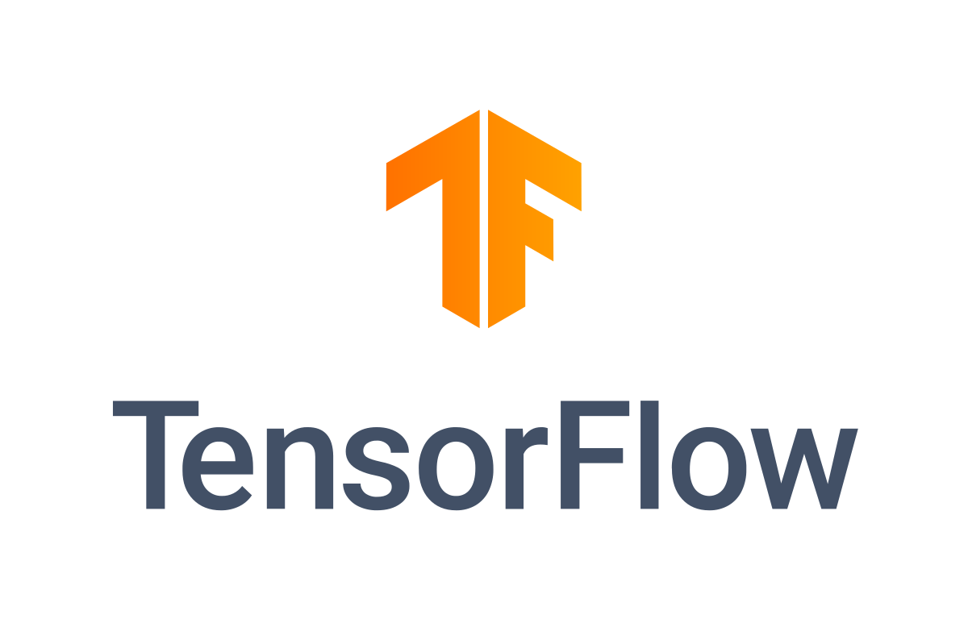

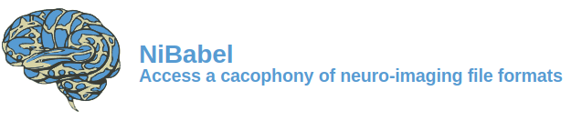
Libraries

Slide 9
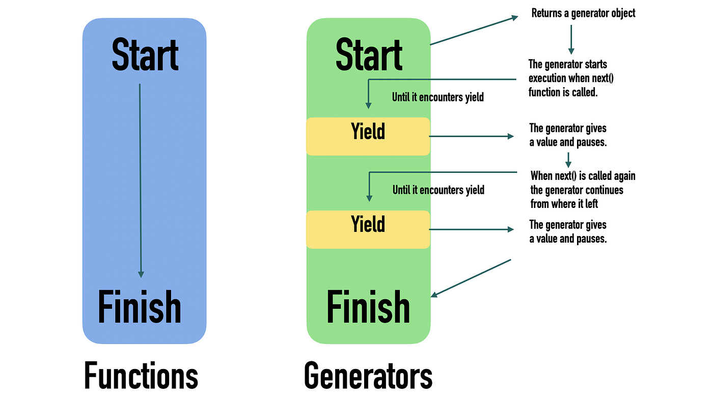
Custom Data Generator

Slide 10


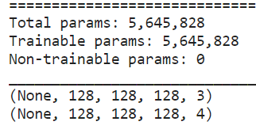
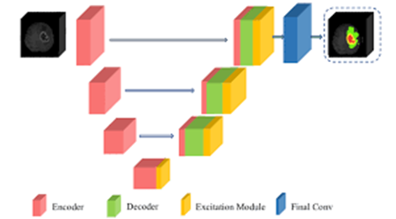
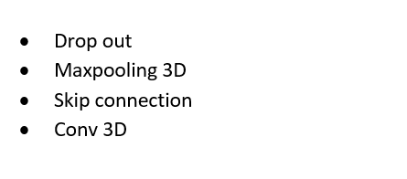
UNet Architect

Slide 11
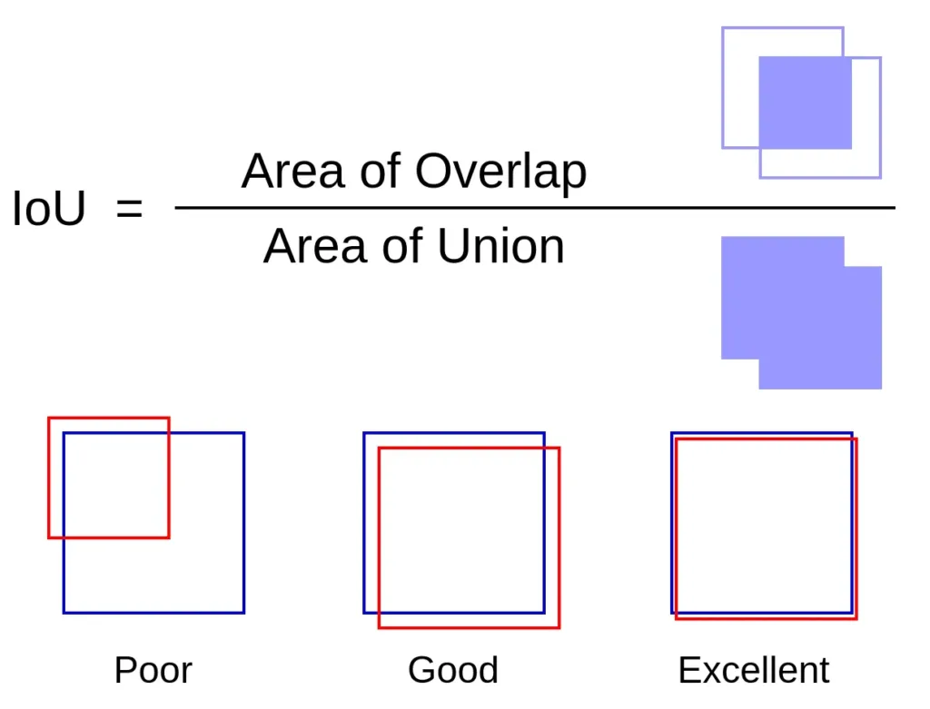
Iou

Slide 12
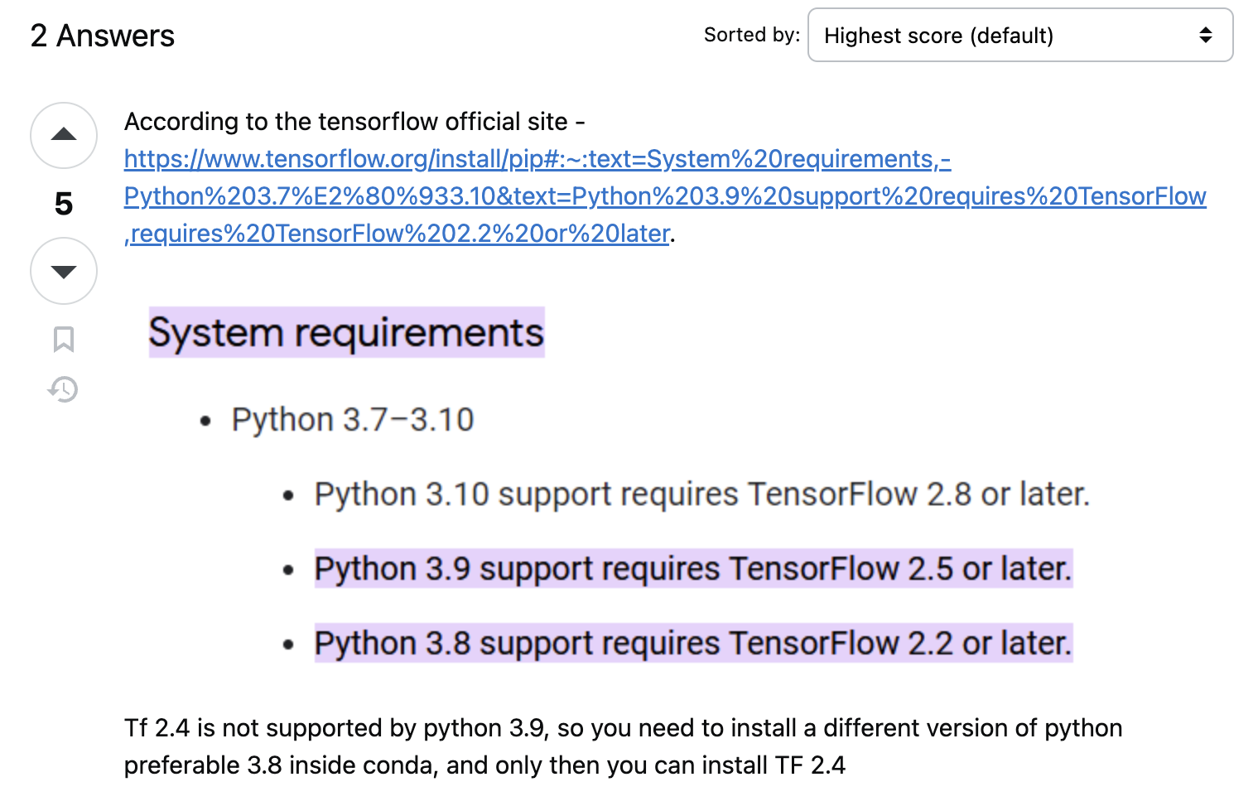
Problem Faced

Slide 13
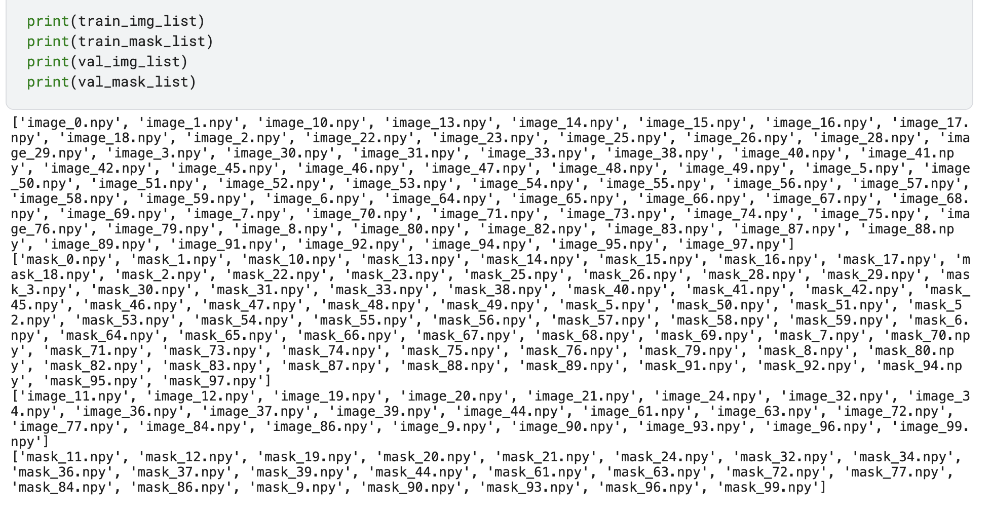
Problem Faced

Slide 14
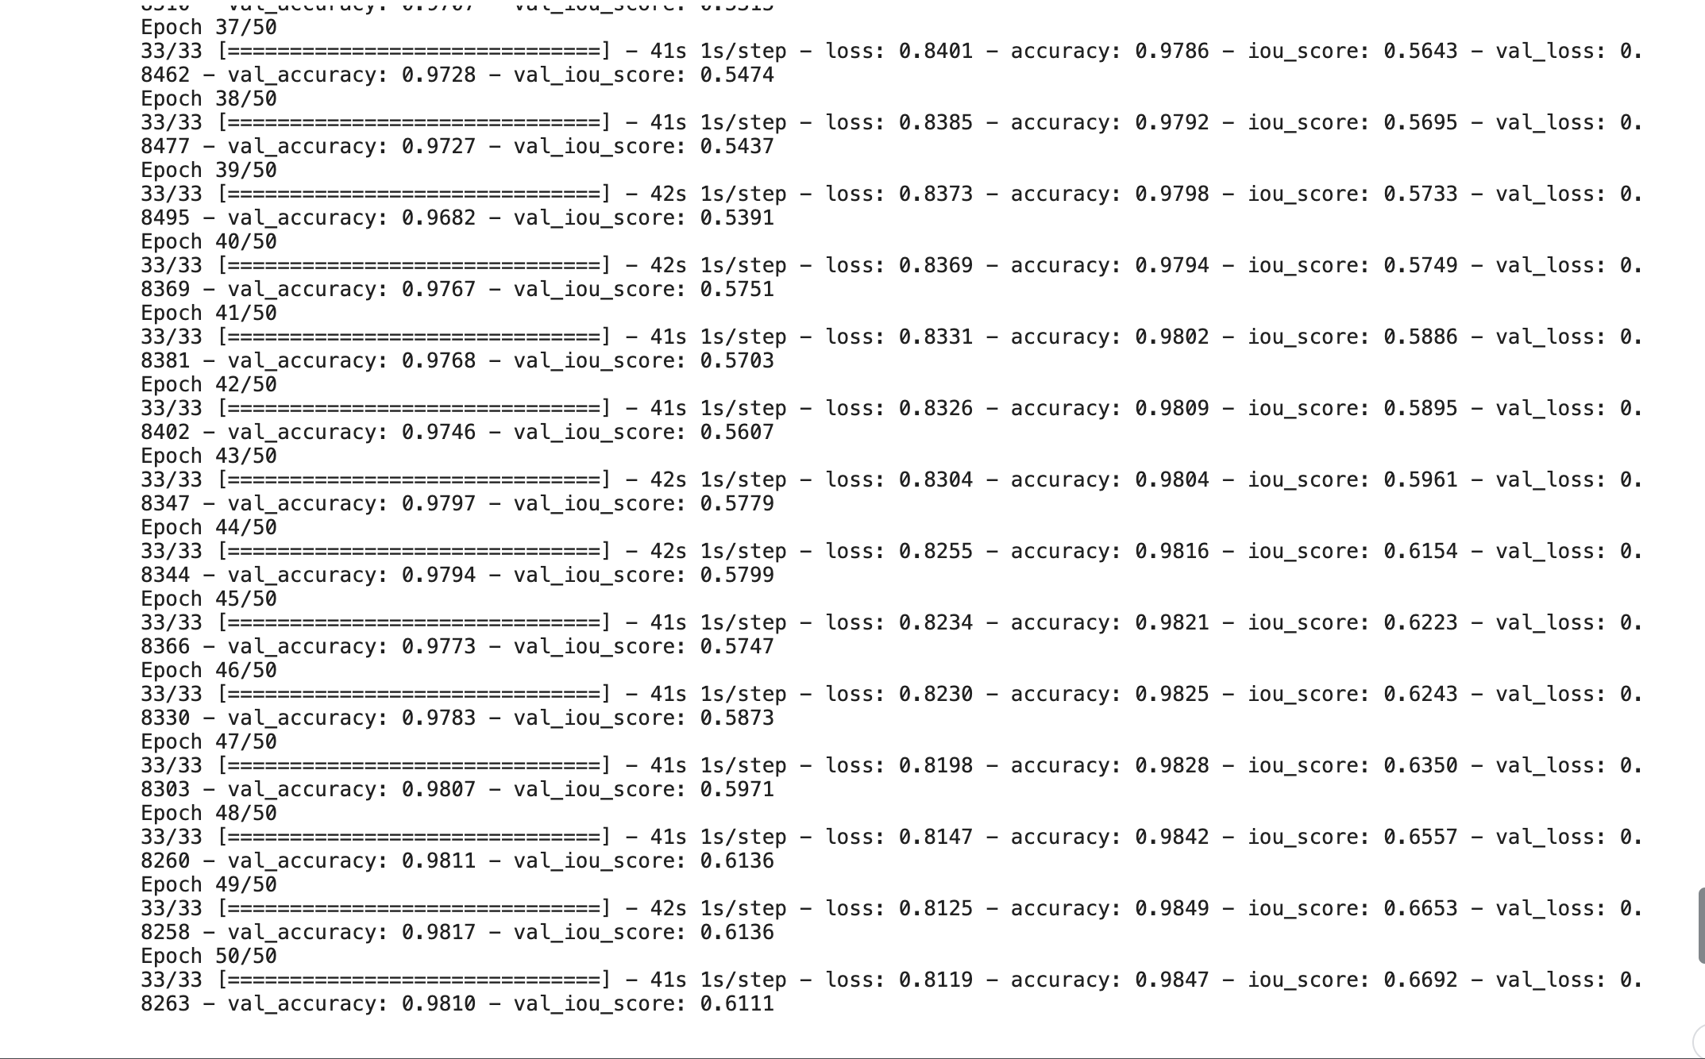
Training

Slide 15
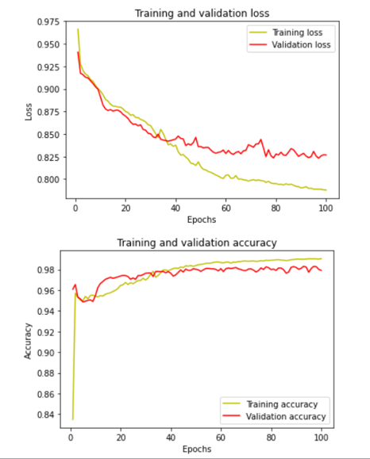
Training

Slide 16

Results
Training
Validation
Loss
81.04%
82.49%
Accuracy
The model achieved exceptionally high accuracy on the training dataset, reaching 98.86%. However, there is a slight decrease in performance when evaluating on the validation dataset,
with an accuracy of 97.65% and an IoU score of 58.91%.
98.51%
98.17%
Intersection over Union (IoU) Score
67.42%
61.62%

Slide 17
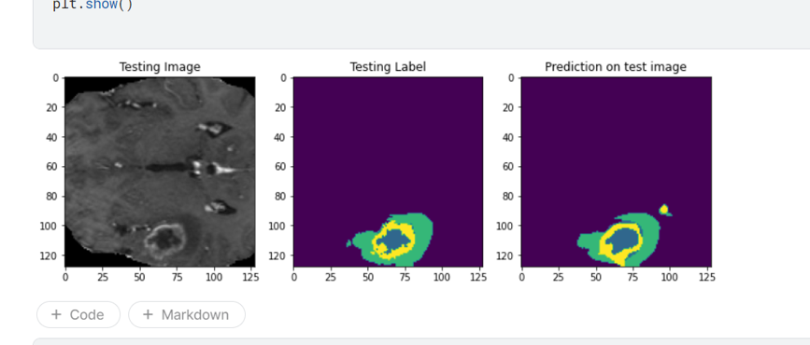
Prediction

Slide 18
Thank You

Slide 19
Any Question?

